Slide 1
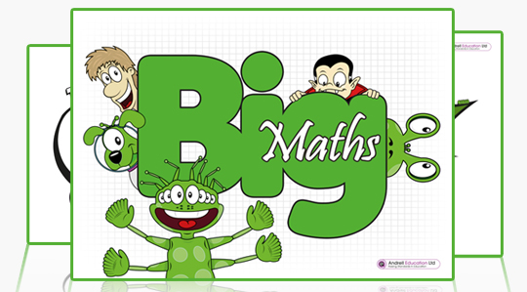
A GUIDE FOR PARENTS AND CARERS
Big Maths is a teaching programme used at Pelsall Village to help children to become numerate. The aim is to provide a consistent approach across all years that will give children the skills to master mathematics. Problem solving and word problems cannot be solved until children can manipulate numbers and understand how the number system works.
Big Maths lessons are fast-paced and fun. The children are introduced to child-friendly terms such as ‘Switchers’ and ‘Learn Its’, to help them manipulate numbers and make them more confident and more successful. There is a strong emphasis on developing instant recall of number facts, including number bonds and times tables.

Slide 2
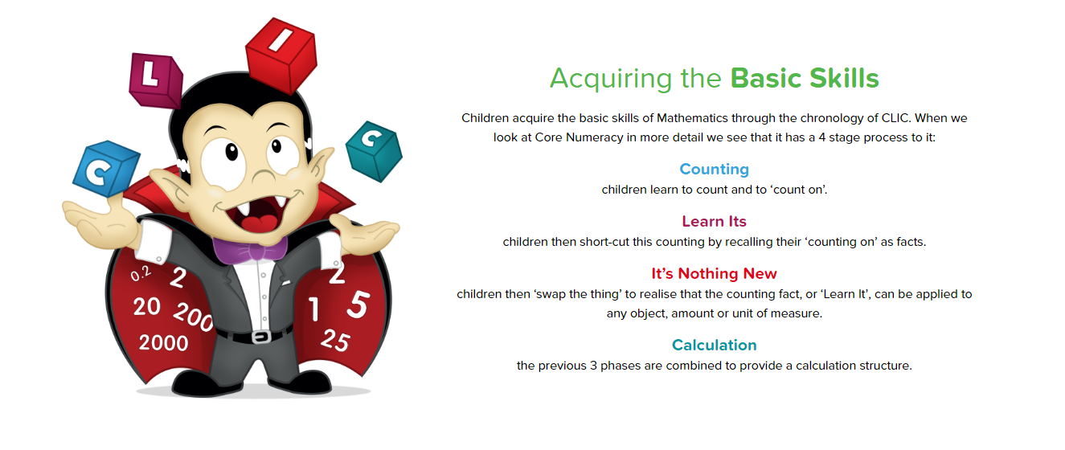

Slide 3
CLIC SESSIONS
This stands for ‘Counting’, ‘Learn Its’, ‘It’s Nothing New’ and ‘Calculation’.
Maths lessons contain each of these elements.
Counting
Children will count forwards and backwards in all kinds of steps depending
on their level e.g. in 1s, 2s, 3s, 6s or even 25s! When practising counting at
home with your child, make sure you go forwards and backwards. Don’t
always start at 0 – make sure they can count on from 75 to 106 for example.
‘Learn Its’
‘Learn Its’ are addition facts and times tables facts. There are 72 Learns Its in total; 36 addition Learn Its and 36 multiplication Learn Its. These are facts that children need to learn off by heart, so when they are asked ‘What is 6+4 ?’ they are able to give the answer as quickly as they would be able to tell you their name. As soon as they know 3x5=15 they also know 5x3=15 (This is known as a ‘Switcher’).

Slide 6
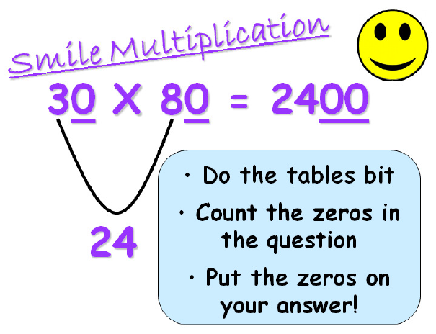

Slide 8
Calculation
This aspect of CLIC is when the teacher will focus on developing the children’s understanding of addition, subtraction, multiplication and division. Big Maths maps out which steps children should do in a clear order and helps teachers to identify where to go back to if a child needs extra support. The methods used in Big Maths ensure a deep understanding of the four operations. Once children have grasped these methods, they will then be taught formal written methods. This is usually when the child reaches Upper Key Stage Two. For further information, please see the calculation guide on our website which demonstrates the methods in further detail.

Slide 10
How can you help?
Big Maths is a very useful tool to help children become numerate… but we still need your support at home.
• Help your child practise their Learn Its at home – a few minutes a day is all you need.
• Insist that numbers are written the correct way round.
• Congratulate your child if their Big Maths score goes up!
• Make maths a positive experience (Don’t tell your child you were no good at maths when you were at school – they will think they should be the same!)
If you have any questions, please see your child’s class teacher in the first instance, or Mr Britton, the school’s Maths Co-ordinator.

