Slide 1
Carousel day
Meet the author

Slide 2
Carousel day
KS1 - Meet the author

Slide 3
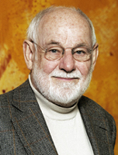
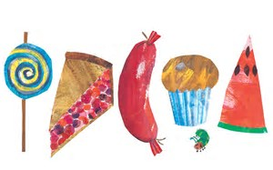
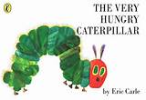
Eric Carle – The Very Hungry Caterpillar
http://www.readingrockets.org/books/interviews/carle
Eric Carle is acclaimed and beloved as the creator of brilliantly illustrated and innovatively designed picture books for very young children. His best-known work, The Very Hungry Caterpillar, has eaten its way into the hearts of literally millions of children all over the world and has been translated into 62 languages and sold over 44 million copies. Since the Caterpillar was published in 1969, Eric Carle has illustrated more than seventy books, many best sellers, most of which he also wrote, and more than 139 million copies of his books have sold around the world.

Slide 4
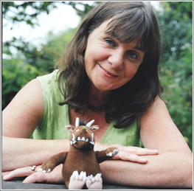
Julia Donaldson
Julia is the award-winning, bestselling author of much-loved modern
classics like The Gruffalo, Stick Man and What the Ladybird Heard.
She was also the Children’s Laureate 2011-2013.
I grew up in a tall Victorian London house with my parents, grandmother, aunt, uncle, younger sister Mary and cat Geoffrey (who was really a prince in disguise. Mary and I would argue about which of us would marry him).
Mary and I were always creating imaginary characters and mimicking real ones, and I used to write shows and choreograph ballets for us.
I studied Drama and French at Bristol University, where I met Malcolm, a guitar-playing medic to whom I’m now married.
Before Malcolm and I had our three sons we used to go busking together and I would write special songs for each country; the best one was in Italian about pasta.
The busking led to a career in singing and song writing, mainly for children’s television.

Slide 5
One of my television songs, A Squash and a Squeeze, was made into a book in 1993, with illustrations by the wonderful Axel Scheffler. It was great to hold the book in my hand without it vanishing in the air the way the songs did. Since then I’ve had 20 plays published.
My real breakthrough was The Gruffalo, again illustrated by Axel. My novel The Giants and the Joneses is going to be made into a film by the same team who made the Harry Potter movies, and I have written three books of stories about the anarchic Princess Mirror-Belle who appears from the mirror and disrupts the life of an otherwise ordinary eight-year-old.
When I’m not writing I am often performing, at book festivals and in theatres. I really enjoy getting the children in the audience to help me act out the stories and sing the songs.

Slide 6
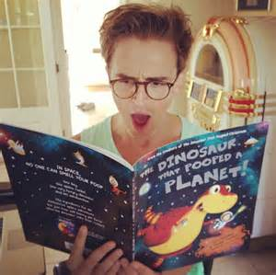
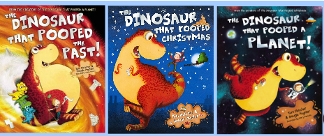
Tom Fletcher
Tom Fletcher loves Christmas and space, Dougie Poynter loves reptiles and they have a shared obsession with poop! After writing songs together for years in the band McFly, they wrote The Dinosaur That Pooped books in the same way that they write their song lyrics.
https://www.penguin.co.uk/articles/on-writing/video/2015/tom-and-dougie-read-from-the-dinosaur-that-pooped-the-past/

Slide 7
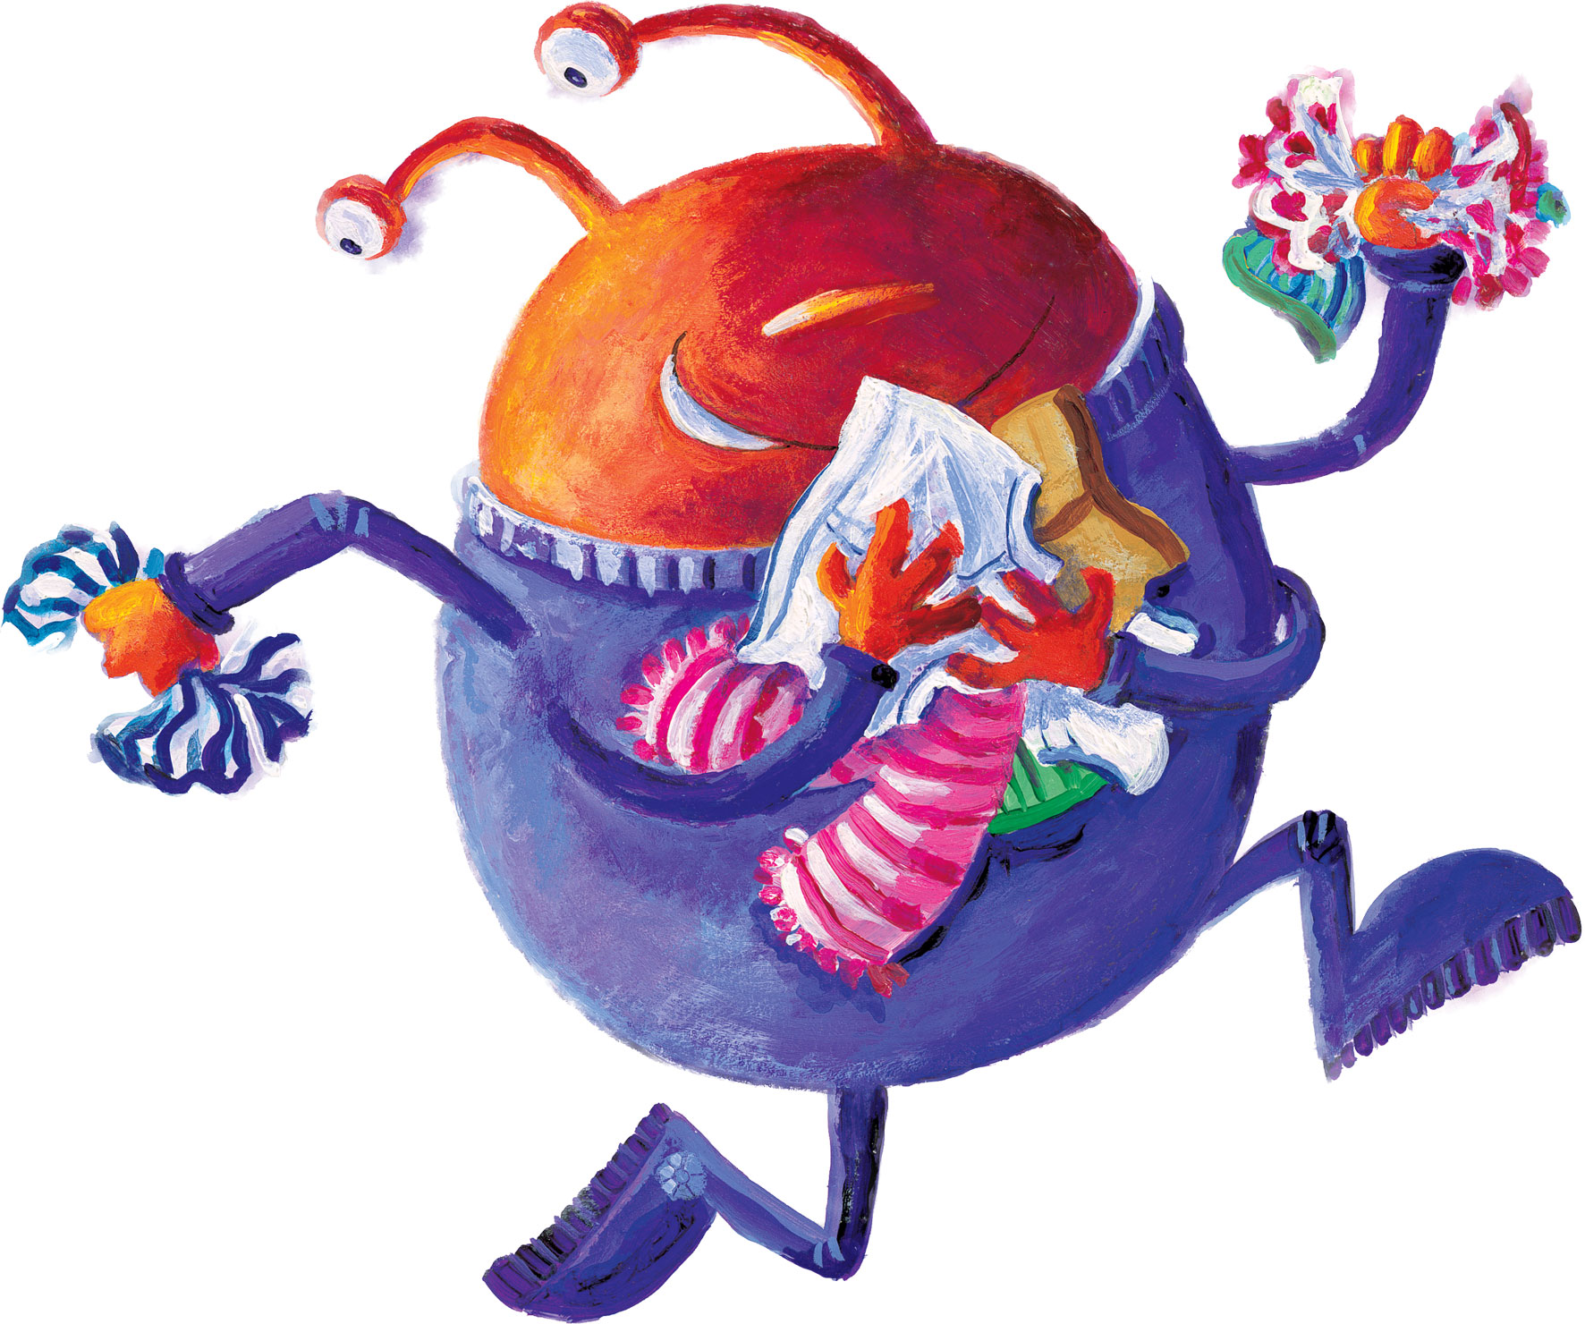
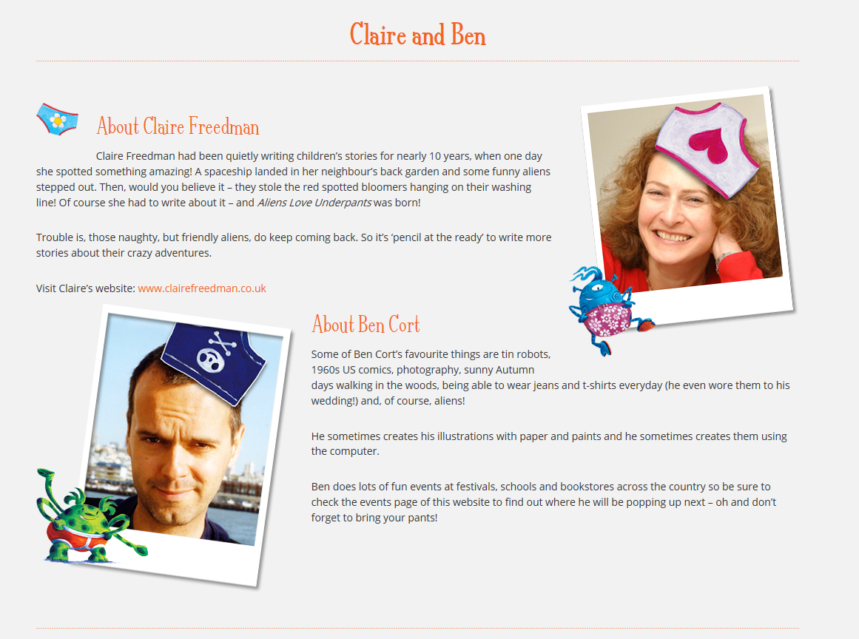
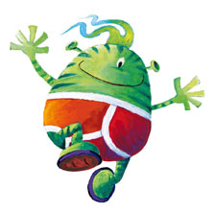
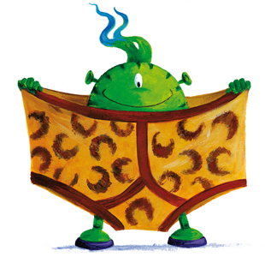
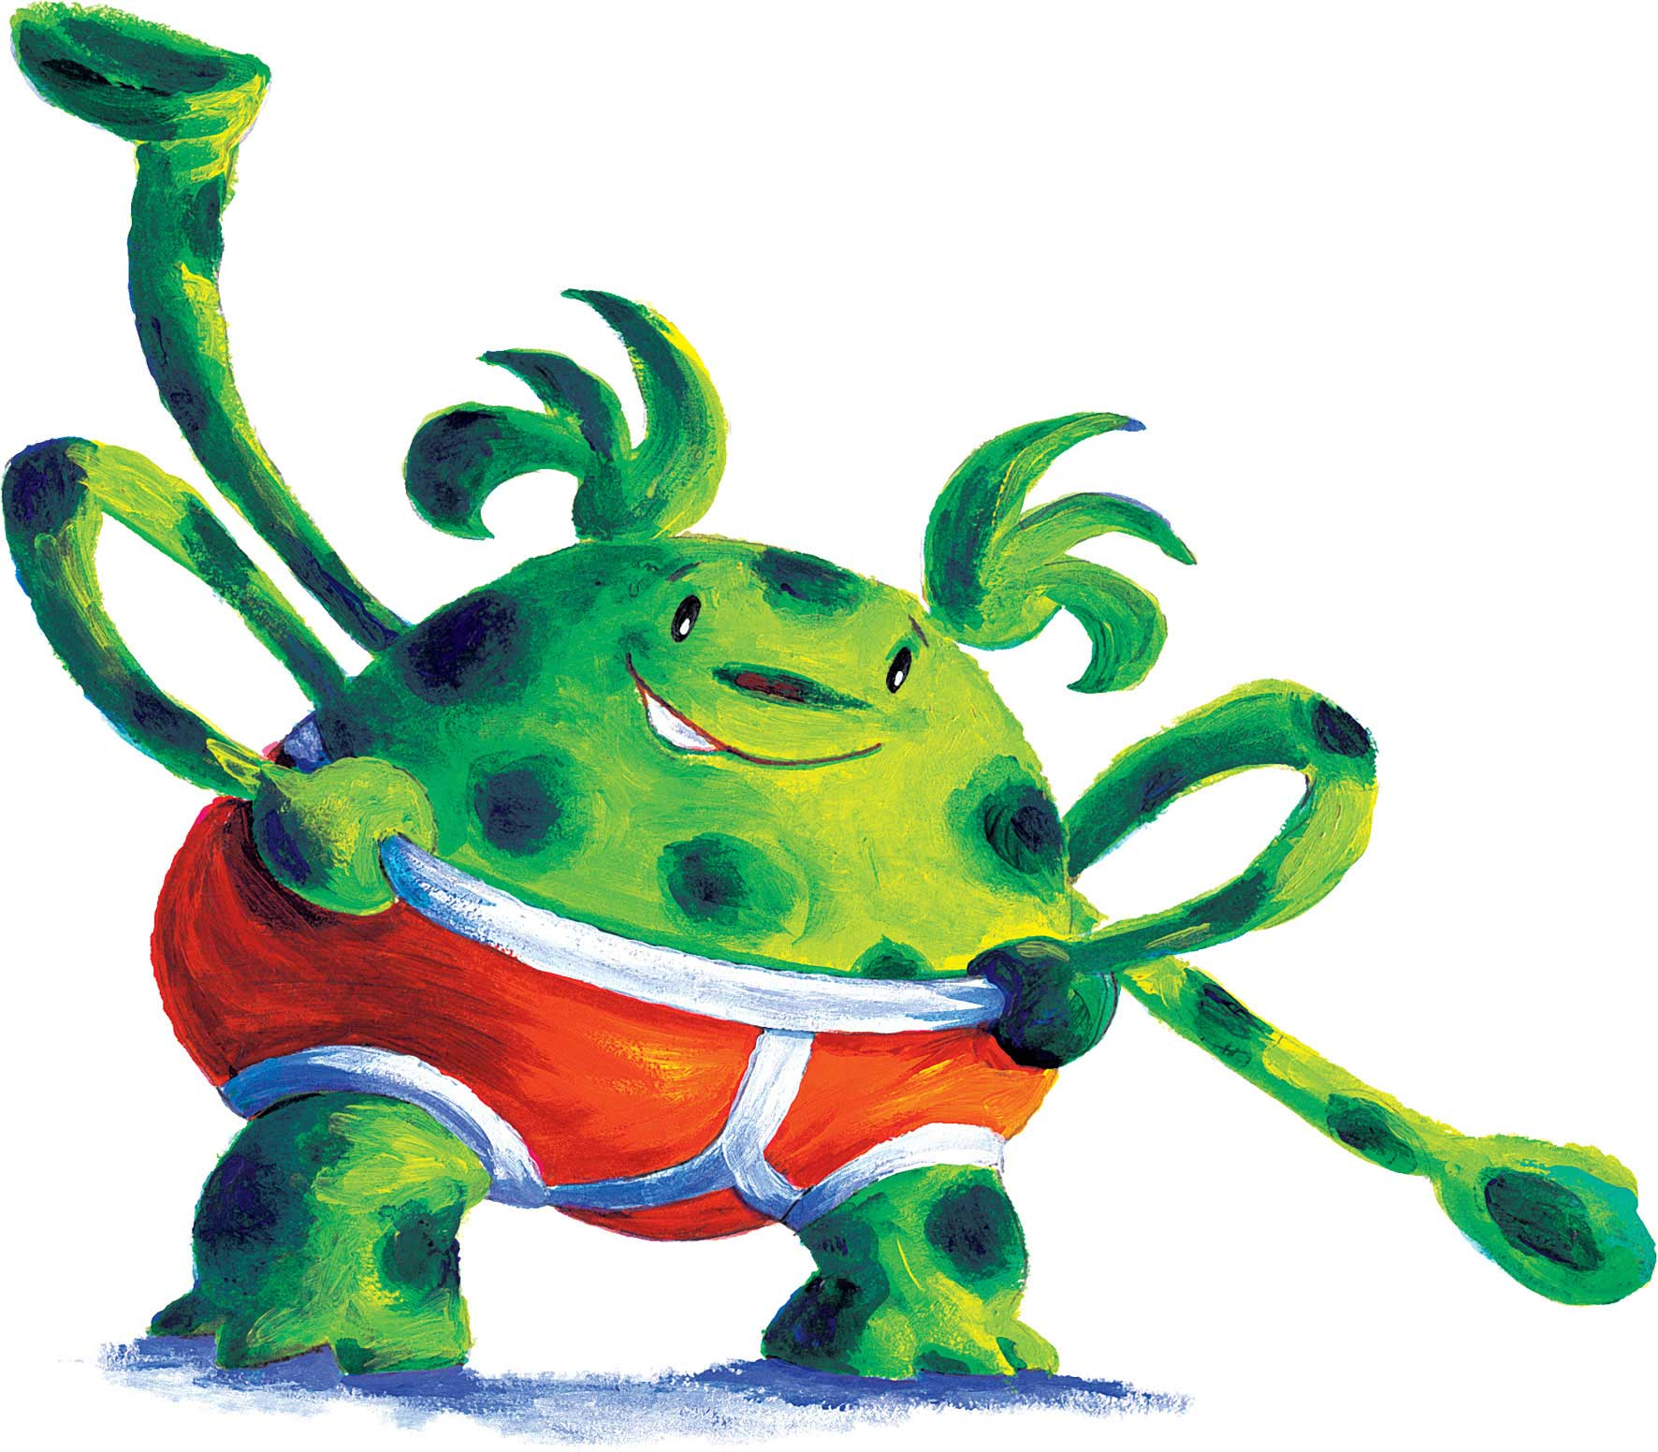
Aliens love underpants

Slide 8
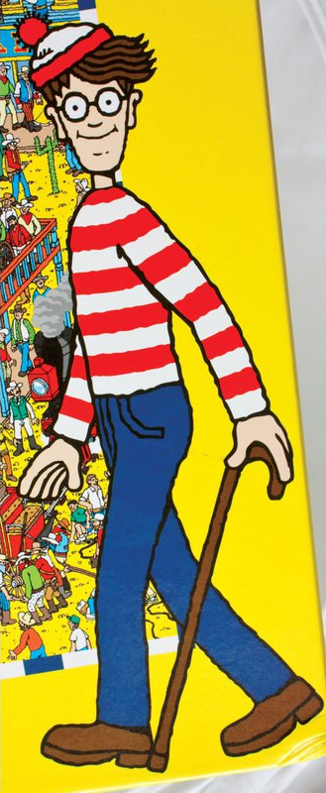
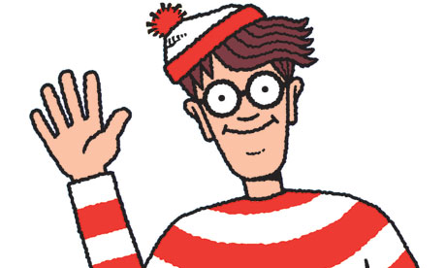
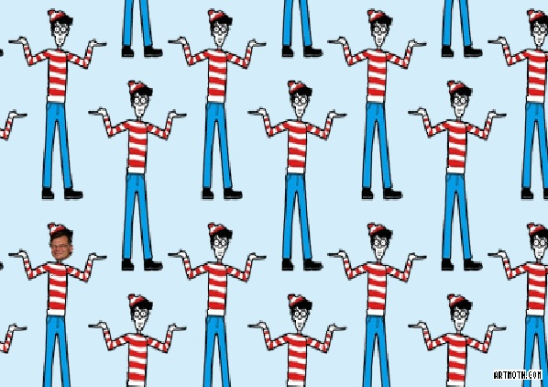
Martin Handford
As a child Martin Handford was born in Hampstead, London, in 1956 and spent most of his childhood drawing.
As an adult Martin worked for three years in an insurance office in order to finance his degree at art college. Following art college, Martin worked as a freelance illustrator specialising in drawing crowd scenes for numerous clients.
As an artist Each Wally picture takes Martin eight weeks to draw. “As I work my way through a picture, I add Wally when I come to what I feel is a good place to hide him,” he explains. Martin describes his pictures as “full of both activity and entertainment. I have a love of situations which contain visual puns.” His own favourite Wally picture is ‘A Tremendous Song and Dance’ from Where’s Wally? In Hollywood.

Slide 9
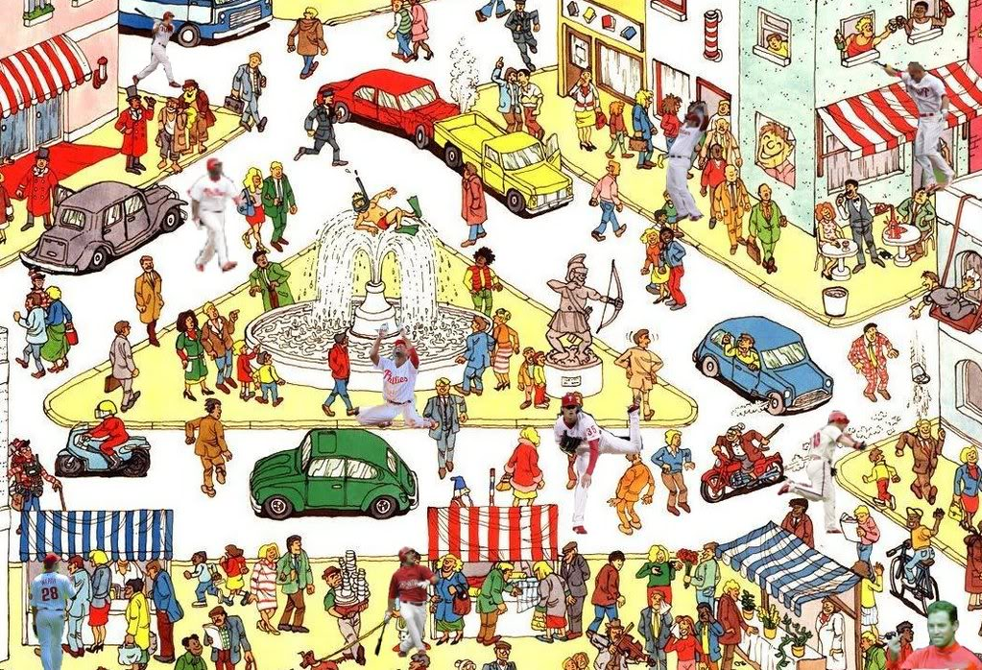

Slide 10
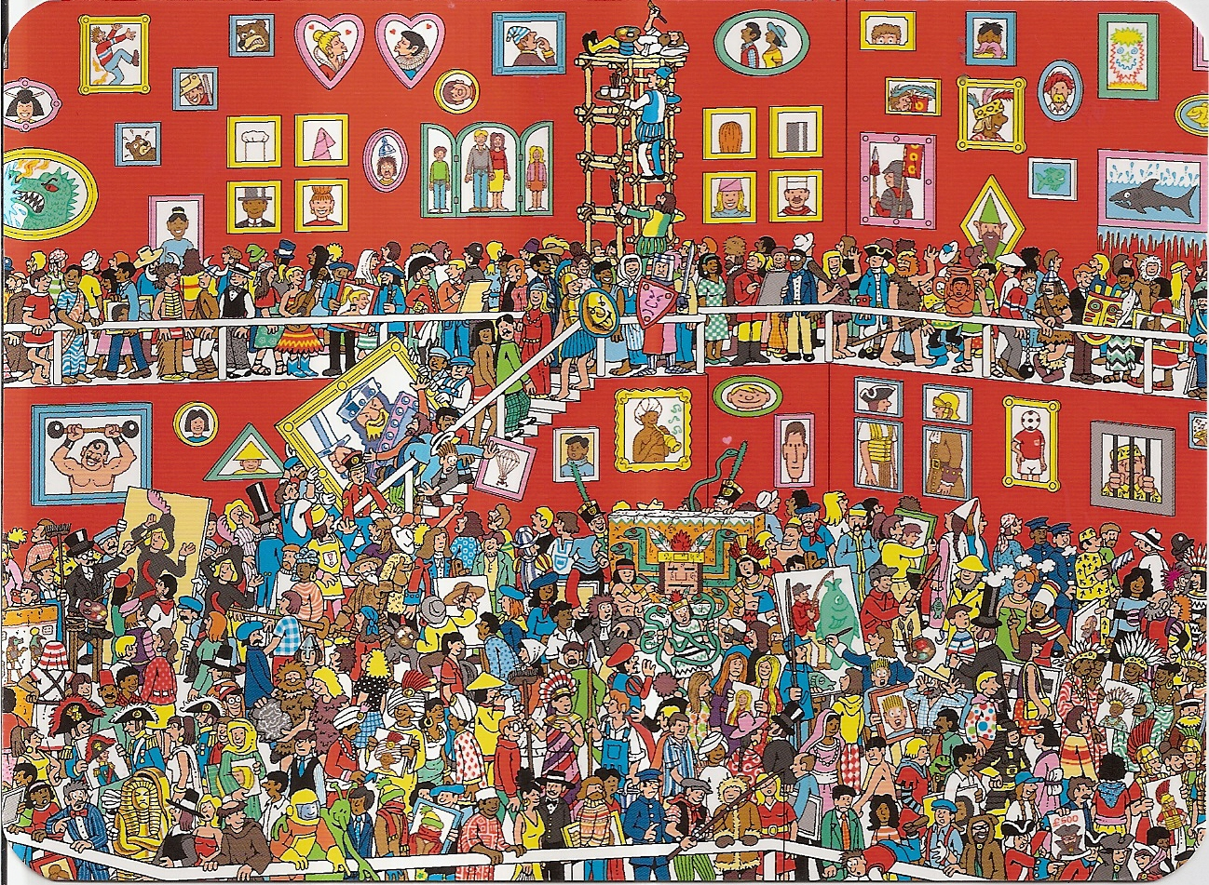

Slide 11
Carousel day
KS2 - Meet the author

Slide 12
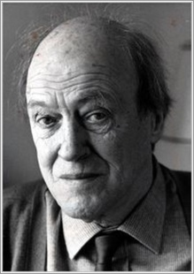
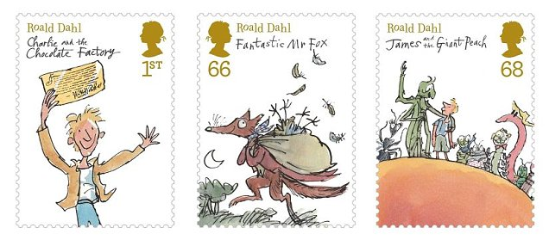
Roald Dahl
Roald Dahl was born in Llandaff, South Wales on September 13th 1916. His first job was in Africa, with the Shell Oil Company. In the second world war he fought as a fighter pilot, and was badly injured when his plane crashed. After the war he worked in America, and soon started writing stories.
His very first children’s book, written in 1943 was called The Gremlins. Eleanor Roosevelt, the wife of the President of the USA liked it so much he was invited to the White House and became friends with the President, Franklin D Roosevelt.
He wrote a number of books and short stories for adults, many of which were televised as the hugely popular Tales of the Unexpected.

Slide 13
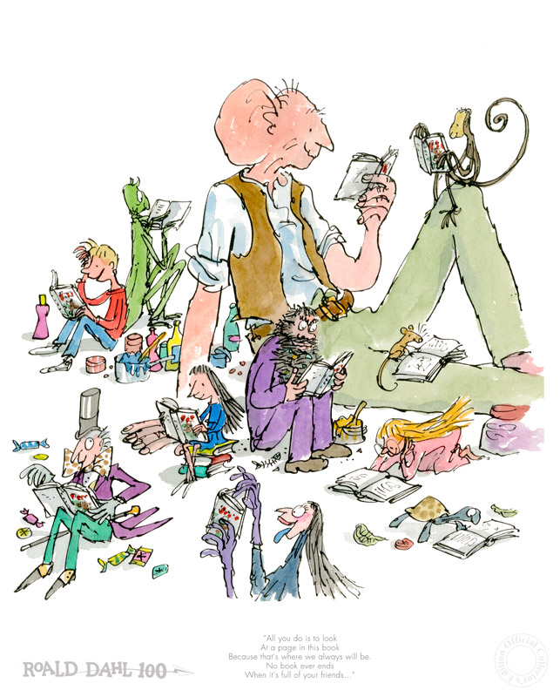
But it was as a children’s author that he found greatest fame and satisfaction, saying “I have a passion for teaching kids to become readers…Books shouldn’t be daunting, they should be funny, exciting and wonderful.” Millions of fans around the world agreed and have chuckled and gasped at his amazing stories. His mesmerising stories, written in sizzling, sparkly language, will lead you into adventures you’ll never ever forget!
From 1945 until his death, he lived at Gipsy House, in Buckinghamshire, where he wrote his famous children’s books. He died in hospital in Oxford, on November 23rd, 1990. His books have continued to be read and loved, and have been made into a number of hit films, including Matilda and Charlie and the Chocolate Factory. You can even visit the Roald Dahl Museum in the village where Dahl lived for most of his life.
In 2009 the Roald Dahl Funny Prize was established in his memory.

Slide 14
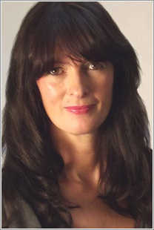
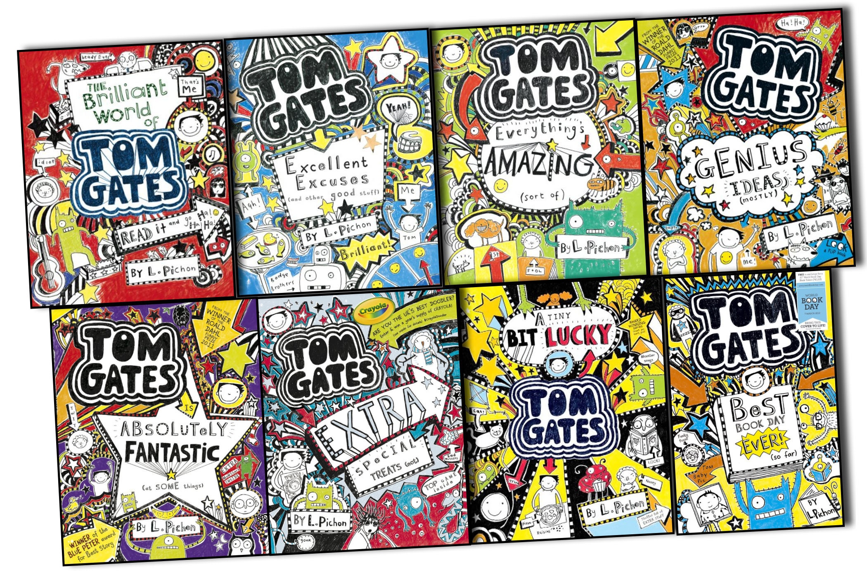
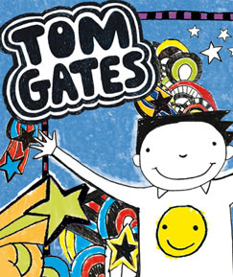
Liz Pichon
When Liz was little, she loved to draw, paint and make things. Her mum used to say she was very good at making a mess (which is still true today!).
She kept drawing and went to art school, where she earned a degree in graphic design. She worked as a designer and art director in the music industry, and her freelance work has appeared on a wide variety of products.
Liz is the author-illustrator of several picture books. Tom Gates is the first series of books she has written and illustrated for older children. They have won several prestigious awards, including the Roald Dahl Runny Prize, the Waterstones Children’s Book Prize, and the Blue Peter Book Award. The books have been translated into forty-one languages worldwide.
Born: 16/08/1963
Studied graphic design in London
Lives in Brighton
Worked for music label Jive Records

Slide 15

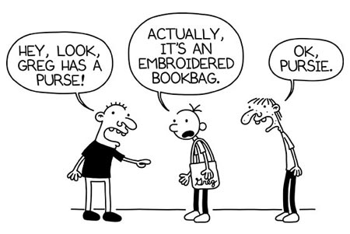
Jeff Kinney
http://www.readingrockets.org/books/interviews/kinney
Born: 19/02/1971
Jeff Kinney is the best-selling author and illustrator of the wildly popular Diary of a Wimpy Kid series, featuring the everyday life of the very relatable adolescent Greg Heffley.
Kinney spent his childhood in the Washington, D.C. area and later moved to New England. As a young reader, Kinney was inspired by the books of Judy Blume, Beverly Cleary, and J.R.R. Tolkien. While a student at the University of Maryland, Kinney decided he wanted to become a cartoonist.

Slide 16

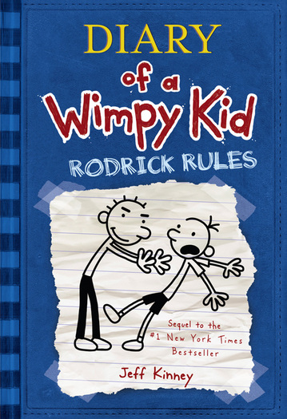
Kinney began doodling ideas for the first Diary of a Wimpy Kid book in 1998, but it wasn't until the spring of 2007 that the book was published — and quickly became a New York Times bestseller, eventually reaching the number one spot. In 2009, Kinney was named one of the 20 Artists & Entertainers in The TIME 100, the magazine's list of The World's Most Influential people. In 2010, Diary of a Wimpy Kid was made into a movie.
Kinney is also a successful online game developer, cartoonist, designer, and the creator of Poptropica, known by children around the world. Poptropica is an online role-playing game designed for kids 6 to 15 where players travel between islands to complete quests.
Kinney currently lives Plainville, Massachusetts with his wife
Julie and their two sons, Will and Grant.

Slide 17
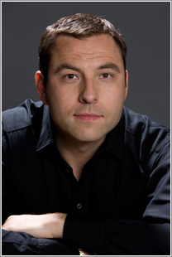
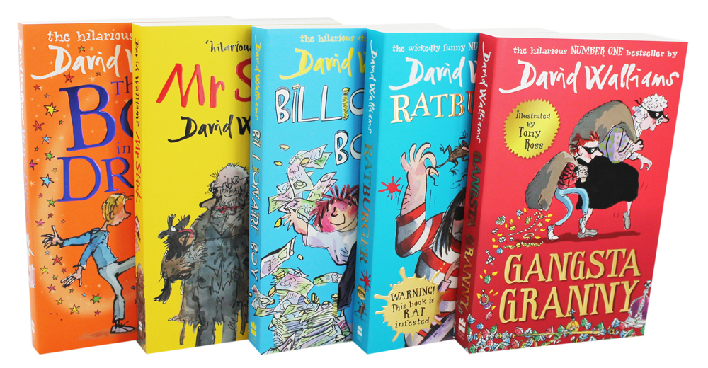
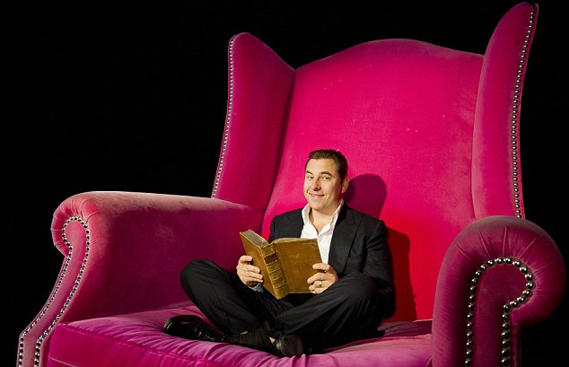
David Walliams (stage name) – real name David Williams
David Walliams is a comedian, writer and actor and is best known for his partnership with Matt Lucas on the hugely popular sketch show Little Britain, and as a star judge on Britain’s Got Talent.
David is also well known for his charitable work for Sports Relief, part of Comic Relief. He took up swimming in his youth because he was overweight, and has subsequently completed long distance swims of the English Channel, the Strait of Gibraltar and the River Thames, raising millions of pounds for charity!
In 2008 David’s first children’s book The Boy in the Dress was published, illustrated by Quentin Blake. He has gone on to take the children’s literary world by storm, dominating sales charts and twice winning the National Book Awards Children’s Book of the Year. His books have now been translated into 40+ languages, and also include picture books illustrated by Tony Ross.
Born: 20/08/1971
Lived in Merton, London.
Won many awards for film, television and his writing.
Won Pride of Britain award for most influential person, 2006.
Written 9 children’s novels and 4 picture books.

